Slide 1
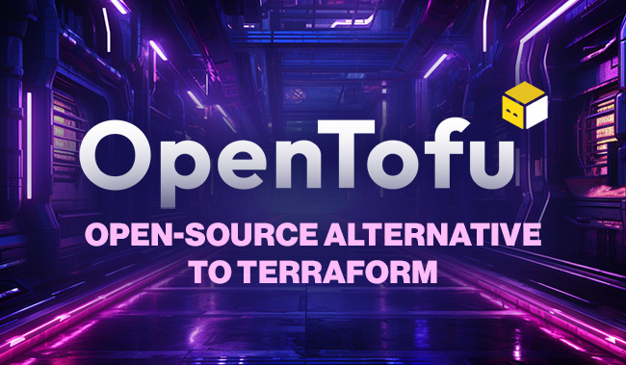

Slide 2

What happens with terraform?
August 10, 2023, HashiCorp announced that after 9 years of Terraform being open source under the MPL v2 license, they were suddenly switching it to a non open source BSL v1. 1 license Terraform is still open-source, but there have been some changes. HashiCorp, the company behind Terraform, This licensing change has caused some users to look for fully open-source alternatives like OpenTofu, which aims to provide an open-source infrastructure-as-code solution without the licensing restrictions imposed by the BSL

Slide 3
It’s time to Migrate Terraform to Open Tofu?
OpenTofu is becoming popular primarily because it stays fully open-source. Unlike Terraform, which moved to a restrictive license (BUSL), OpenTofu continues to allow users to:
Use and Modify Freely: There are no restrictions on how you can use or modify the software, which is appealing to those who prefer the freedoms of open-source.
Distribute Without Restrictions: You can distribute OpenTofu without worrying about legal or commercial limitations that are imposed by Terraform's new license.
Community-Driven: It benefits from strong community support and contributions, which helps in keeping the project transparent and aligned with open-source principles.

Slide 4
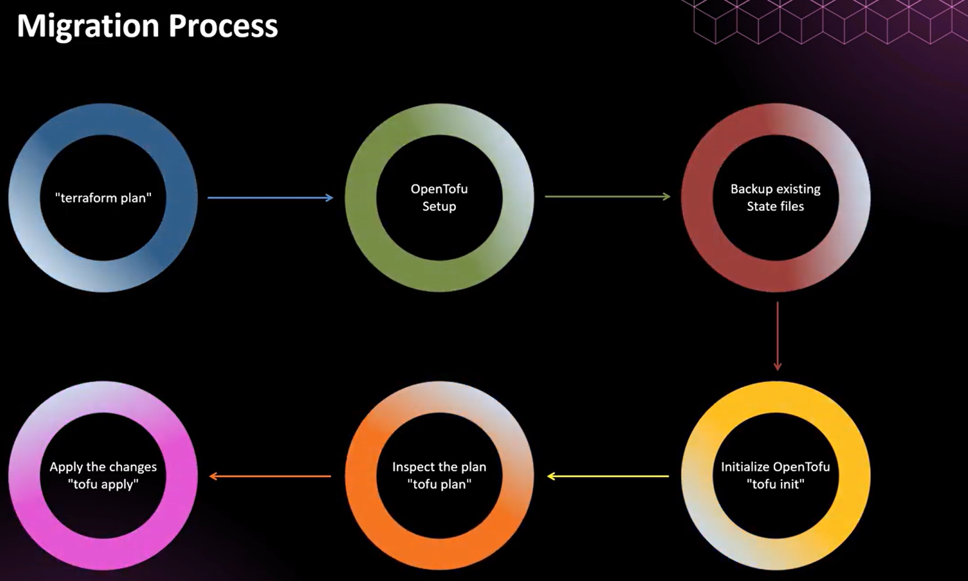

Slide 5
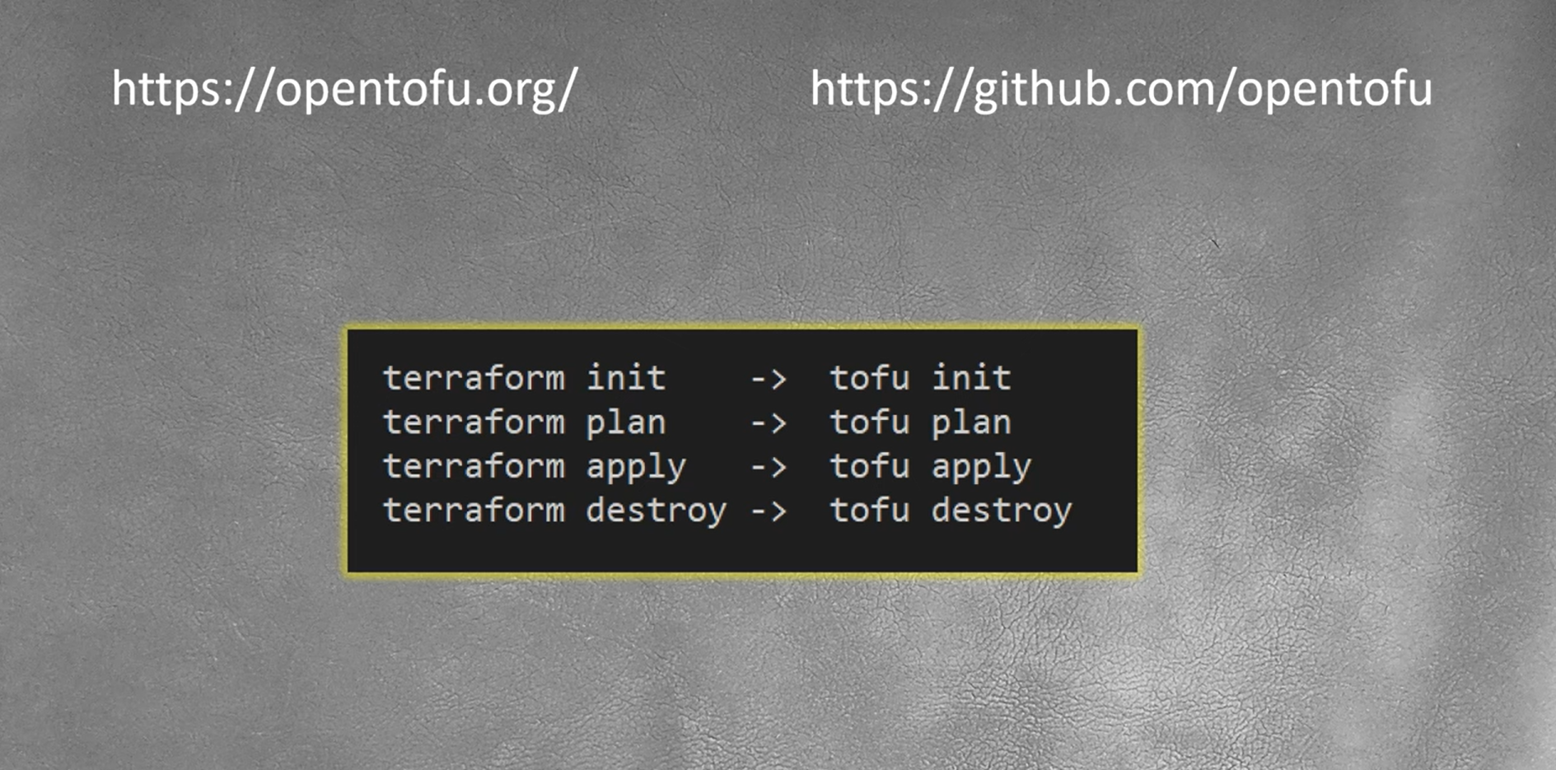

Slide 6
What is Terraform statefile
The Terraform state file (terraform.tfstate) is a critical component in Terraform that records the infrastructure's current state as represented by Terraform's configuration. It serves the following purposes:
Infrastructure Tracking: It tracks the current state of the resources that Terraform manages. This allows Terraform to understand what it has previously created, updated, or destroyed in order to apply changes efficiently.
Resource Mapping: It maps real-world resources (like an EC2 instance in AWS) to your Terraform configuration. When you apply changes, Terraform compares the state file with your configuration and the actual cloud infrastructure to decide what needs to be created, modified, or destroyed.
Collaboration: If you're working in a team, the state file needs to be shared (typically stored in remote storage like AWS S3) so multiple users can work with the same infrastructure.
Locking: Terraform state locking is a mechanism to prevent multiple concurrent operations on the same infrastructure. It ensures that only one Terraform process can modify the state at a time

Slide 7
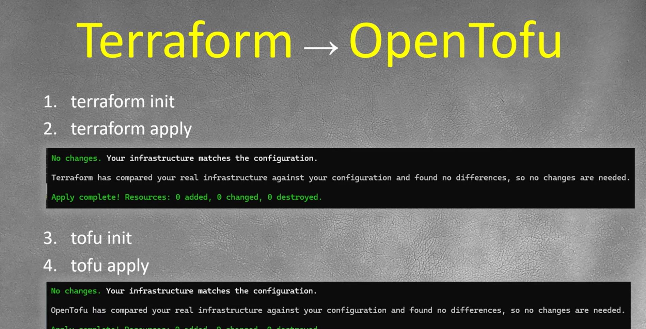

Slide 8
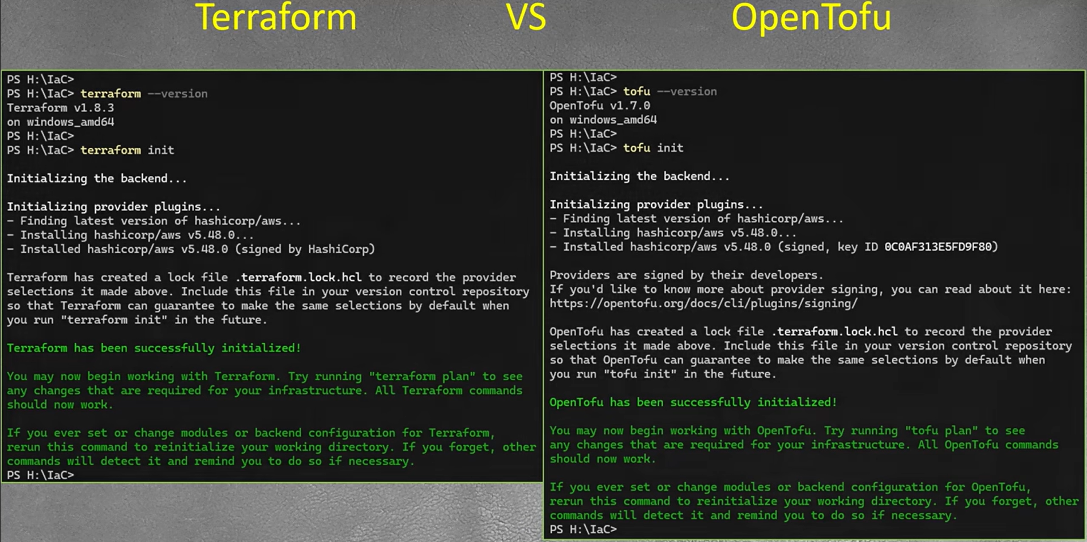

Slide 9
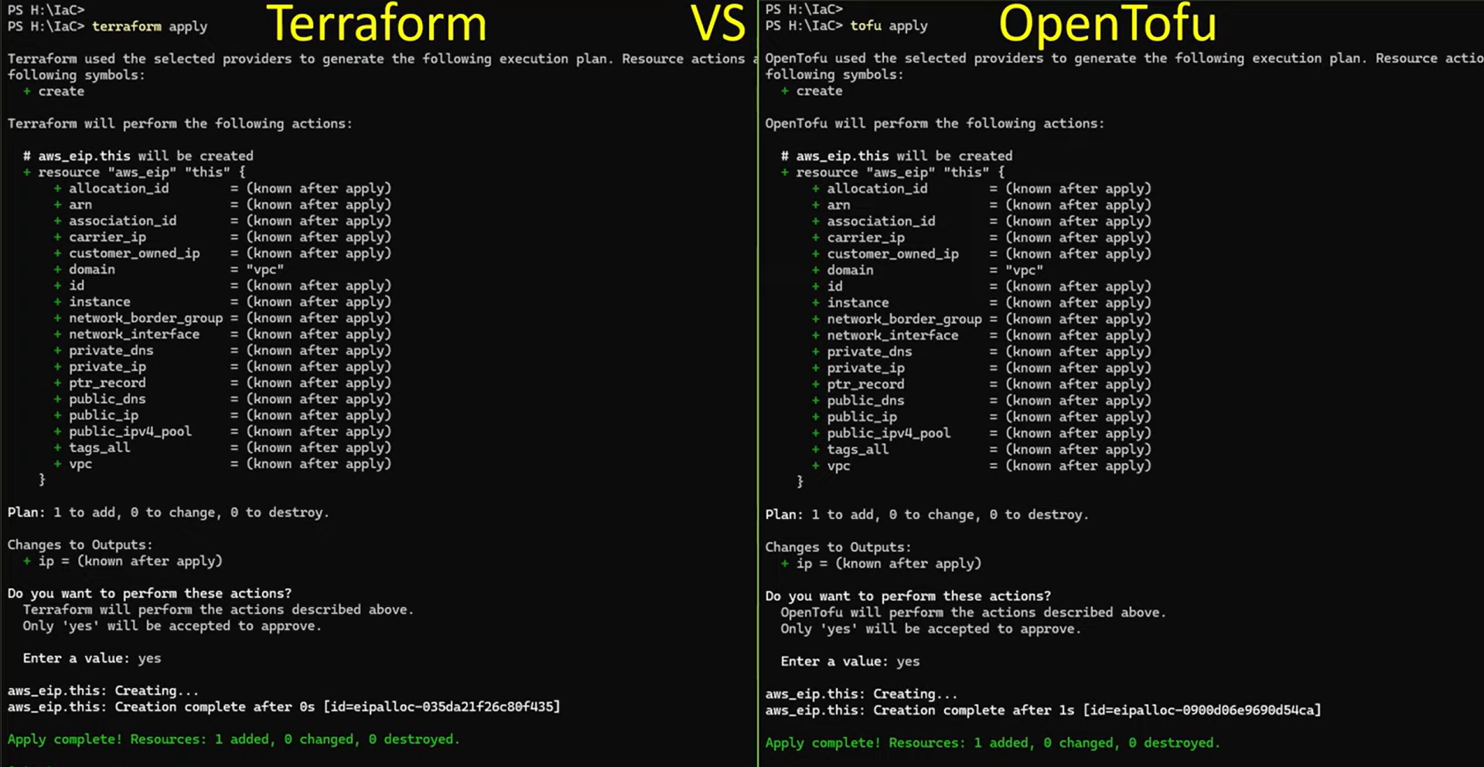

Slide 10
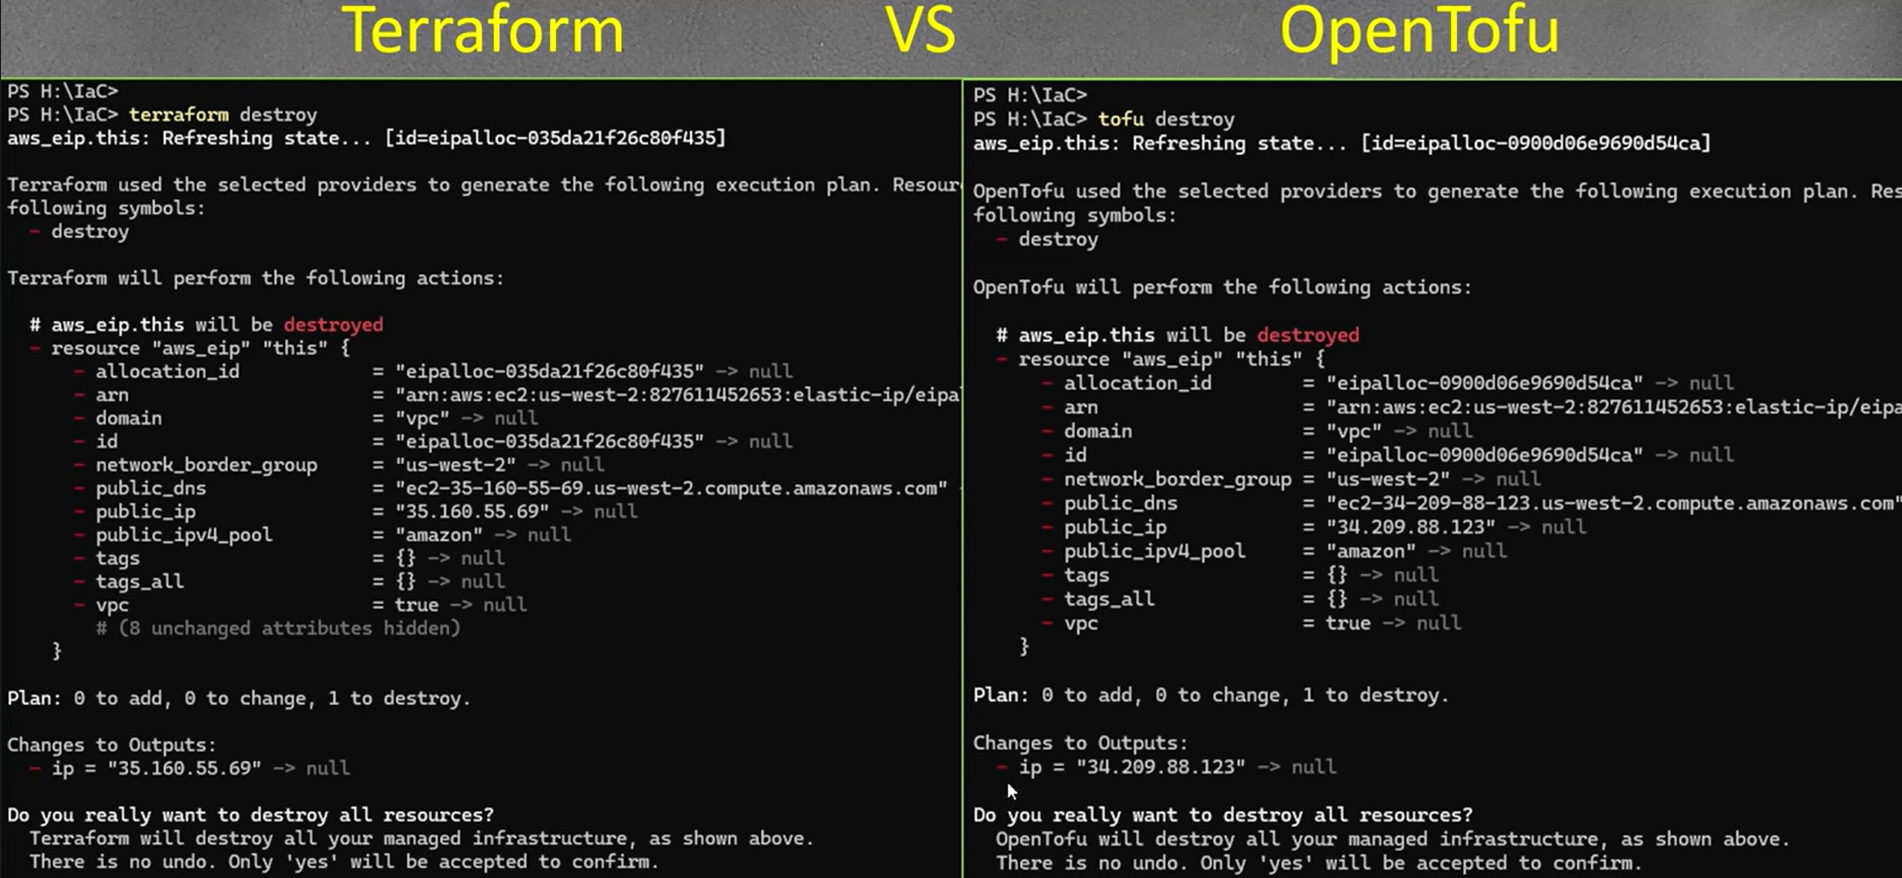

Slide 11
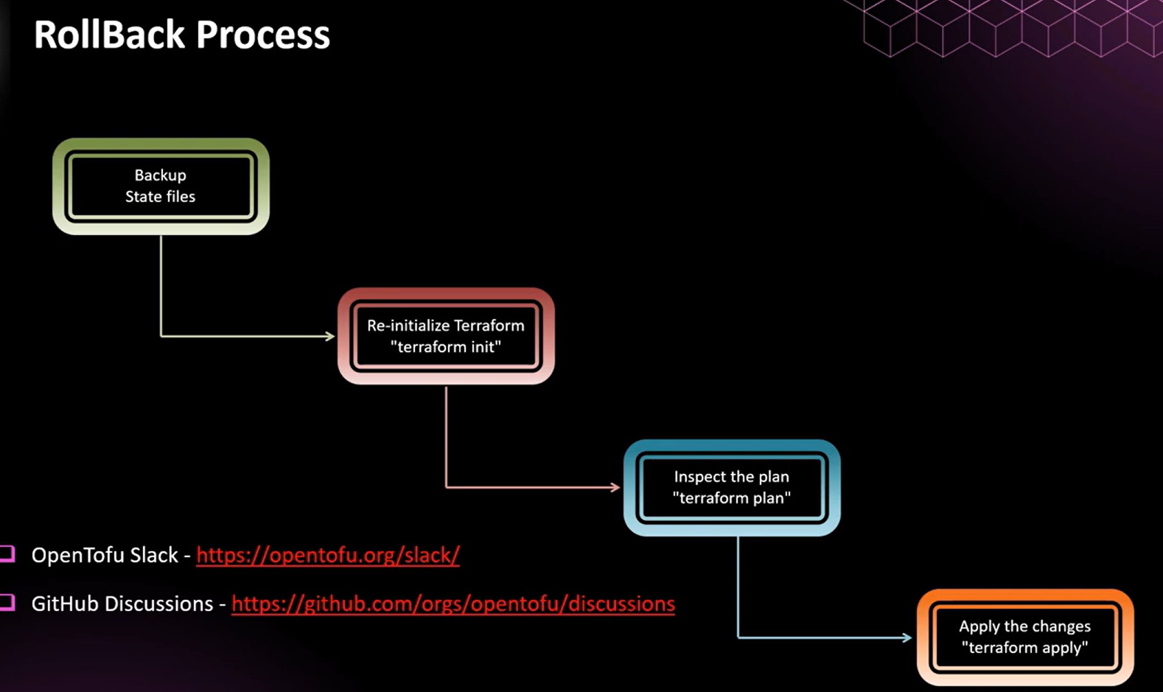

Slide 12
Present :===
terraform {
required_version = ">= 1.7.0"
required_providers {
aws = {
source = "hashicorp/aws"
version = ">= 5.59.0"
}
}
}
Future:===
tofu {
required_version = ">= 1.8.0“ #required_version = ">= 1.8.0" #open tofu version
required_providers {
aws = {
source = "opentofu-community/aws" # Hypothetical future OpenTofu provider source
version = ">= 5.0"
}
}
}

Slide 13
Resume Points
Automated cloud infrastructure provisioning and management across AWS, Azure, and GCP using Terraform, reducing manual interventions and increasing deployment efficiency.
Developed reusable and scalable Terraform modules to standardize the deployment of resources across different environments, streamlining infrastructure setup and reducing code duplication.
Configured cross-region replication of Terraform statefiles in cloud environments (e.g., AWS S3), ensuring high availability and quick disaster recovery in the event of a regional failure.
Leveraged Terraforms state file versioning to perform rapid rollbacks during disaster recovery scenarios, reducing service downtime and ensuring infrastructure consistency.
Configured remote backends (S3 with DynamoDB for AWS, GCS for GCP) for storing Terraform statefiles, enabling distributed access, locking, and versioning for effective disaster recovery.
Designed and implemented automated backup strategies for Terraform statefiles, ensuring quick recovery from accidental deletions or corruption, minimizing infrastructure downtime.
Led the migration from Terraform to OpenTofu, leveraging its community-driven support and open-source features to ensure continuity in infrastructure-as-code practices.
Automated cloud infrastructure deployments using Open Tofu, an open-source alternative to Terraform, across multiple environments (dev, staging, and production).
Integrated OpenTofu into CI/CD pipelines (Jenkins, GitLab CI) to enable continuous delivery of infrastructure changes, improving deployment frequency and minimizing downtime.
Managed OpenTofu state files for team-based collaboration, ensuring efficient infrastructure tracking and consistency across deployments.

Slide 14


